Slide 1

PROG6212 POE
Chase Miller - St10433939

Slide 2

The Contract Monthly claim system was made for lecturers to be able to submit their claims which are then either verified and approved or rejected by the program manager and academic coordinator. In the final part an HR was introduced to allow for Lecturers to only be added through the hr.
Overview

Slide 3
the changes made in accordance to lecturer feedback is as follows: the manager and coordinator views were completed in the second part and additional UI changes were introduced for slightly more colour. Changes made with regard to the feedback from the second part was the adding of visible error messages to users when errors occur.
Changes

Slide 4

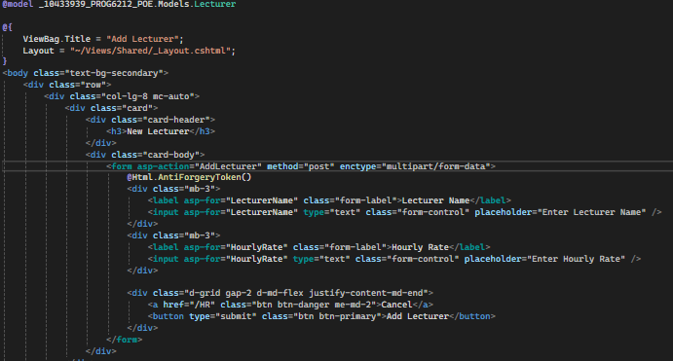
Features added:
The addition of an HR view to allow for lecturers to be added.

Slide 5
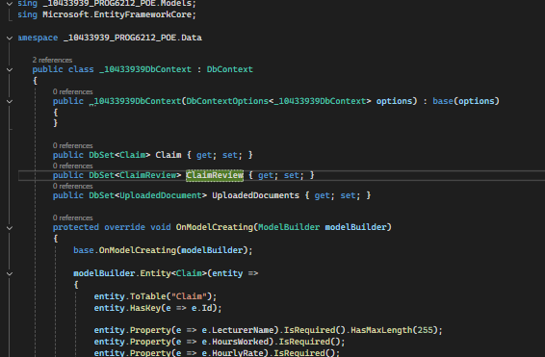
The creation of a Db context class for data from the application to be stored in a database and able to be re-read.

Slide 6
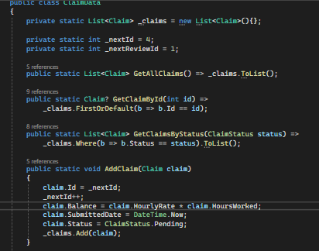
Added a new variable called balance that automatically takes a lecturers hours worked and rate to produce their claim amount.

Slide 7

THANK YOU
Chase Miller
ST10433939

